Slide 1
WebSockets & Notifications in Browser
Speaker: @DamianMontero
Brought to you by Tech Events . Ninja

Slide 2
Who am I
Or why you should listen

Slide 3
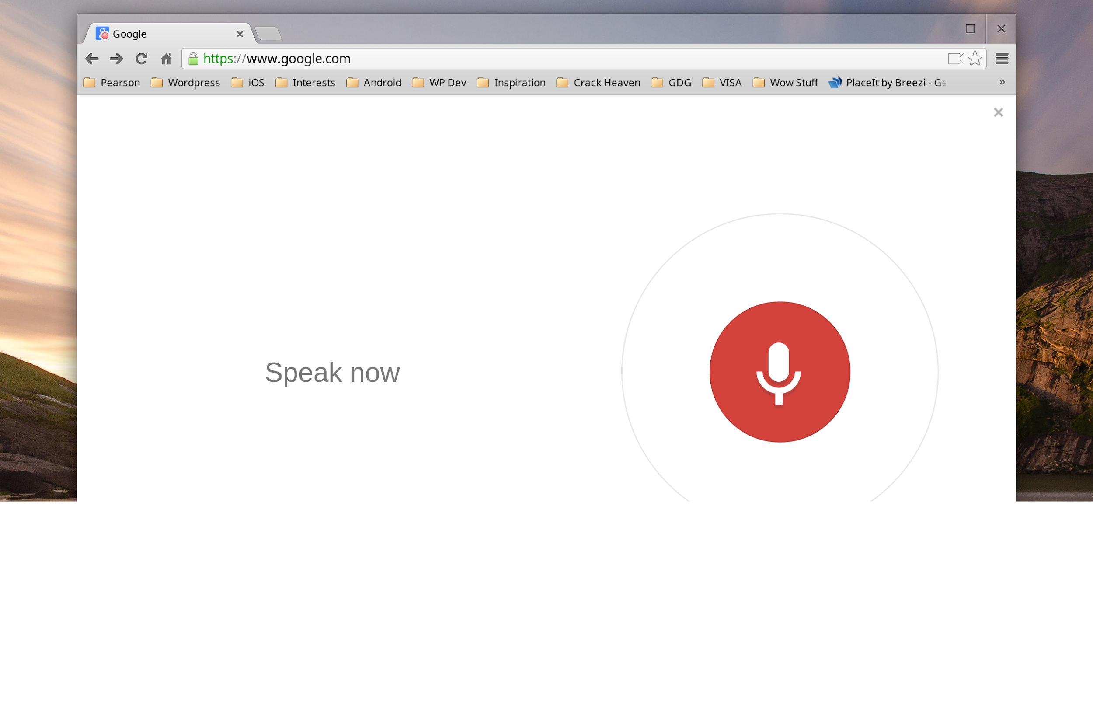
Who am ?

Slide 4
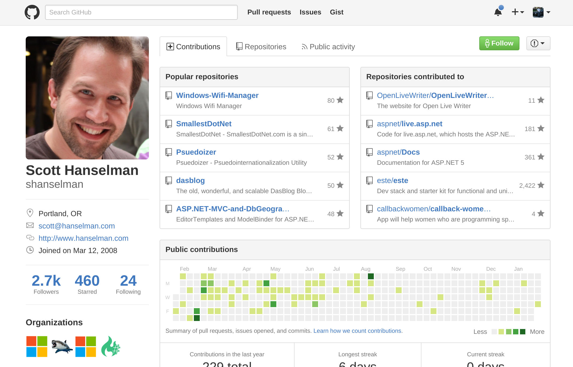

Slide 5
Who am ?

Slide 6
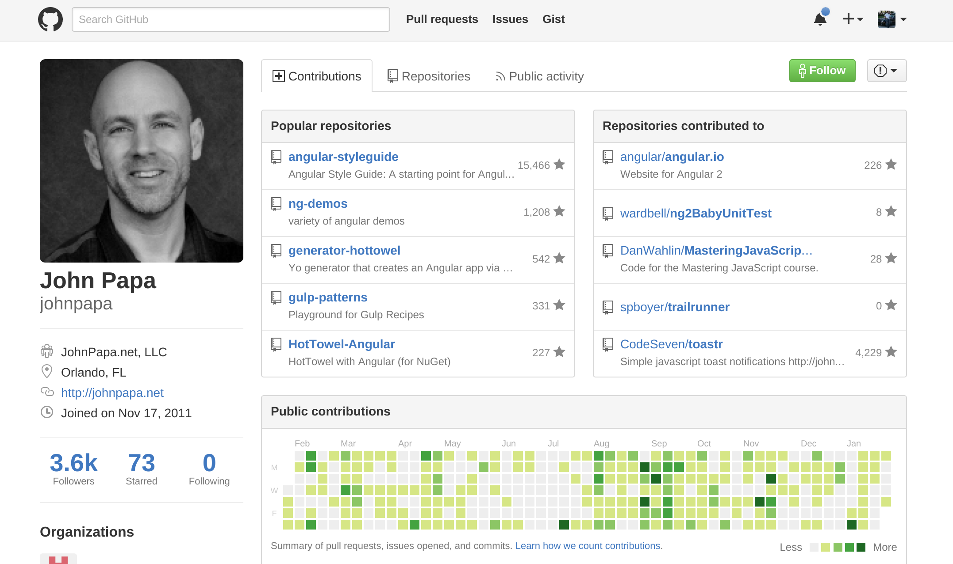

Slide 7
Who am ?

Slide 8
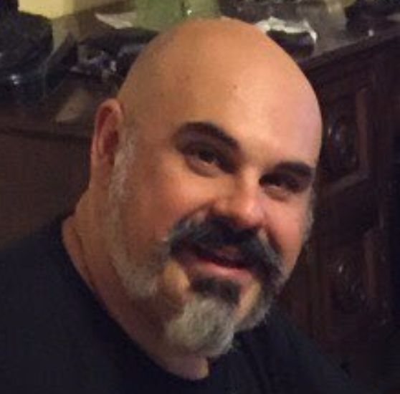
Damian
Montero
19 Years Web Developer
Worked for Skype, Microsoft, Circuit City (not my fault!)
5 Hackathon Wins
Including “Best HTML5 App” at the AT&T Developer Summit in Las Vegas
Did I mention Mobile
Made the Code Camp Mobile App.

Slide 9


Slide 10


Slide 11
Walk the Walk
Let’s start with a demo!

Slide 12


Slide 13




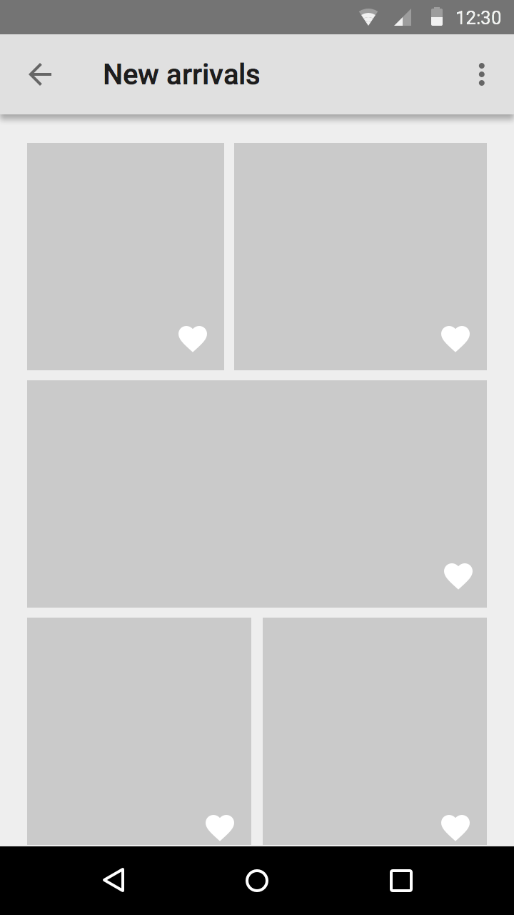
How we did it?
Check every second
Java or Flash
Magic?

Slide 14

WebSockets
It’s Magic!

Slide 15


Slide 16
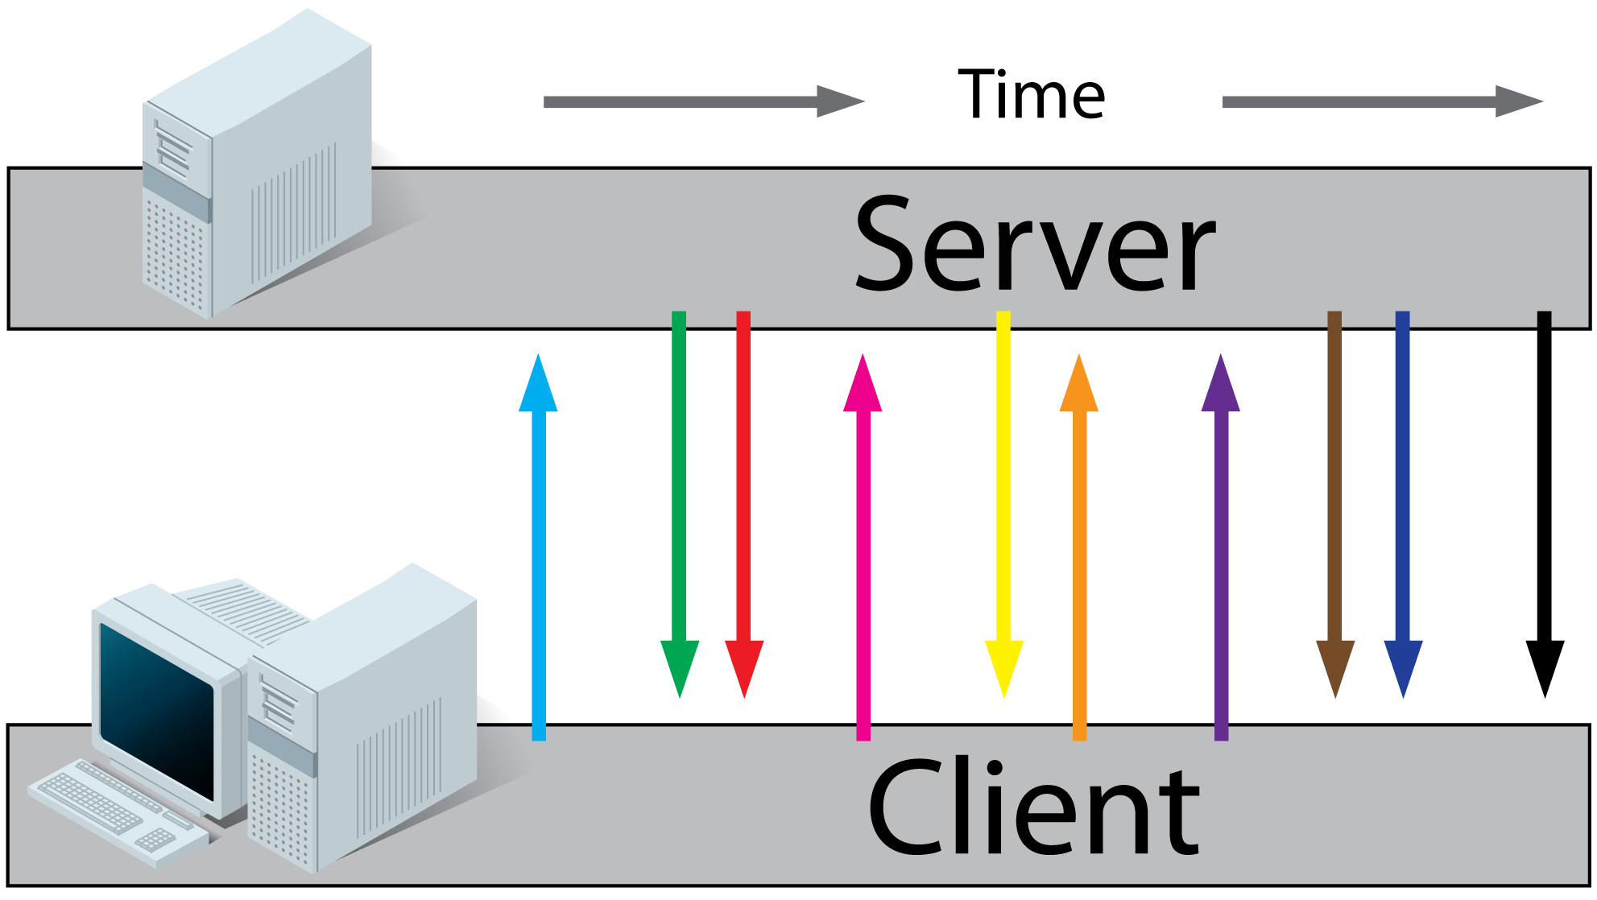

Slide 17
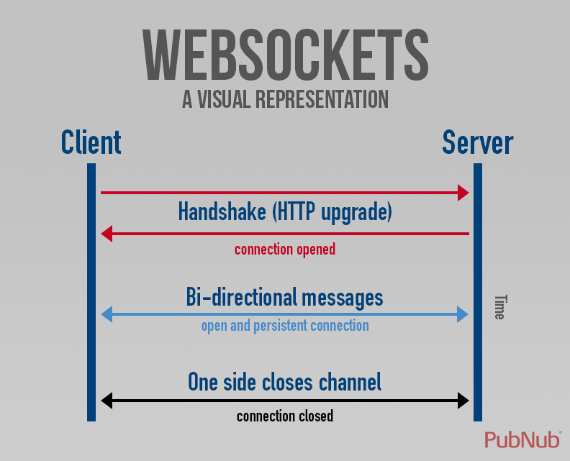

Slide 18
Code or GTFO
http://x.co/wsdemo or Web Socket Demo . Heroku App.com

Slide 19
github.com/thedamian/websocket-node-example
CLIENT var ws=new WebSocket(location.origin.replace(/^http/,'ws'));
// Receiving from server ws.onmessage = function (event) { var msg = JSON.parse(event.data) };
//send message to sever ws.send("stop");

Slide 20
github.com/thedamian/websocket-node-example
Server (node) var WebSocketServer = require("ws").Server ... var wss = new WebSocketServer({server: server}) wss.on("connection", function(ws) { // Send to Client ws.send(JSON.stringify(new Date()),function(){ });} // Receive from Client ws.on('message', function incoming(message) { // message variable from client }); // on connection

Slide 21
Does it always work?
eh….no….

Slide 22
Sockets.io & SignalR
doing it smarter
Ajax Long Polling
Sockets
Endless Javascript
ForeverFrame

Slide 23




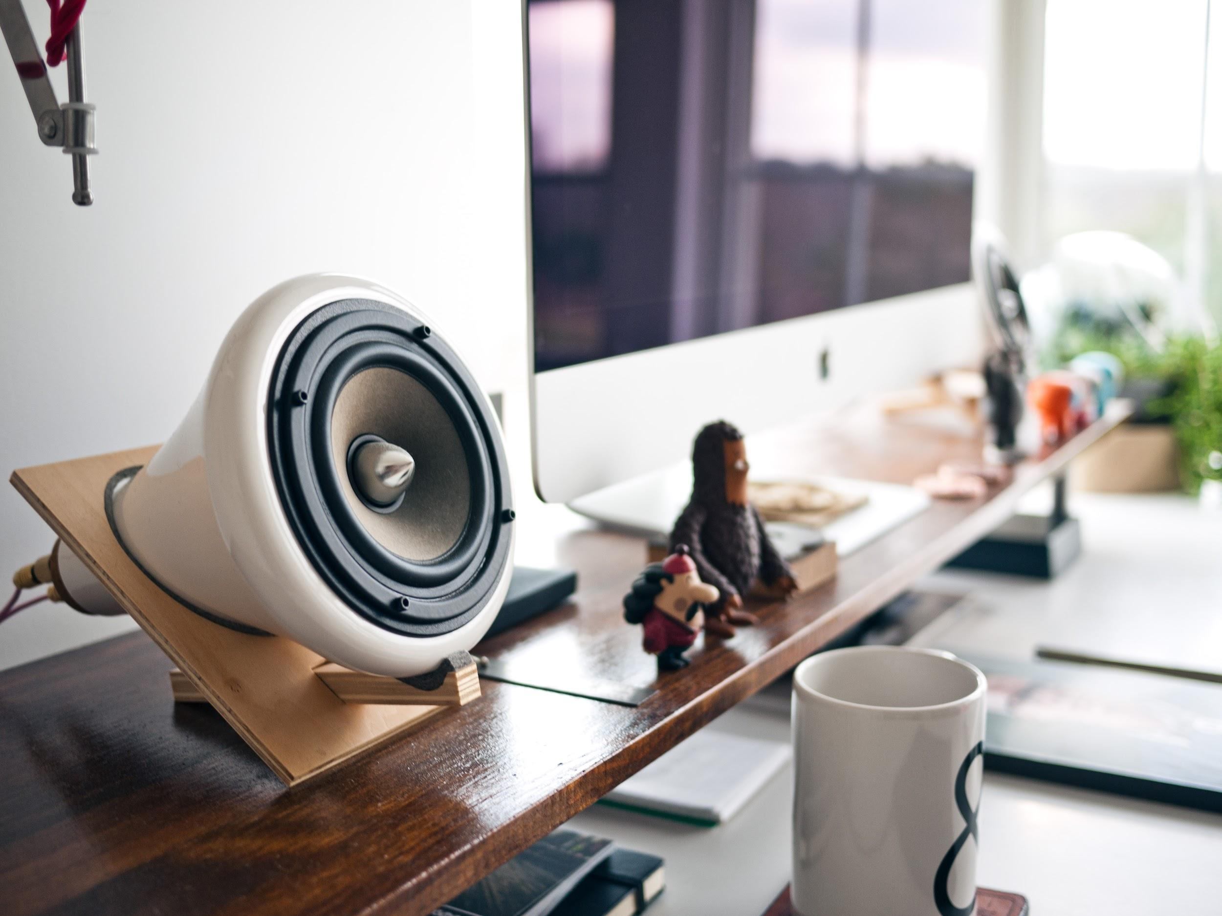


Socket.IO
SignalR
Open source, started in node, available in a lot of platforms.
Open source. a microsoft product, the first to use all four “tricks”

Slide 24
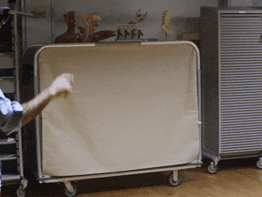
Socket.IO
SignalR
Open source, started in node, available in a lot of platforms.
Open source. a microsoft product, the first to use all four “tricks”

Slide 25
Notifications
Or how to get them back!

Slide 26
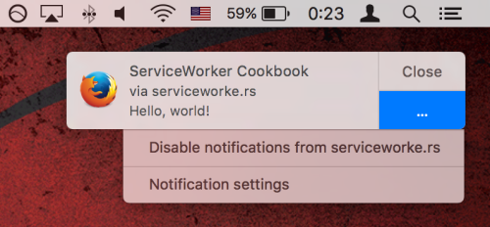
Chrome Safari & now Firefox have them

Slide 27
How to:
http://deanhume.com/Home/BlogPost/ push-notifications-on-the-web---google-chrome/10128

Slide 28
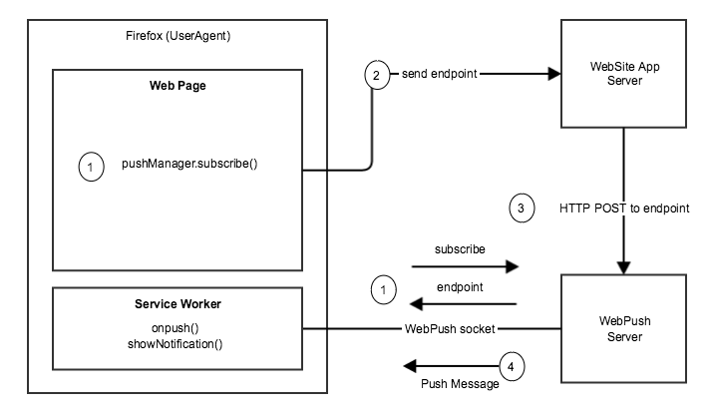

Slide 29

http://x.co/websocket
Twitter: @DamianMontero
github.com/thedamian
www.socket.io
asp.net/signalr
Notification example:
jsfiddle.net/pksLuhys/
Web push: http://deanhume.com/Home/BlogPost/push-notifications-on-the-web---google-chrome/10128

